Slide 1
Special effects
Introduction to WebGL 3D with HTML5 and Babylon.js

Slide 2


WHO ARE WE?
Geeks, web developers, 3D addicts
DAVID ROUSSET
DAVID CATUHE
TECHNICAL EVANGELIST
PRINCIPAL PROGRAM MANAGER
Twitter: @davrous
http://blogs.msdn.com/davrous
Twitter: @deltakosh
http://blogs.msdn.com/eternalcoding
Do not try to tune your speakers, the weird sound is due to French accent…

Slide 3


Course topics
Introduction to WebGL 3D with HTML5 and Babylon.js
Day One
01 | 3D on the Web: Understanding the Basics | 02 | WebGL Basics
03 | Using Babylon.js for Beginners | 04 | Understanding materials and inputs
Day Two
01 | Game Pipeline Integration with Babylon.js | 02 | Loading Assets
03 | Babylon.js: Advanced Features | 04 | Special Effects

Slide 4
AGENDA
1
Shadows
2
Environment
3
Lens Flares
4
Particles
5
Post-processes

Slide 5
Section One
Shadows

Slide 6
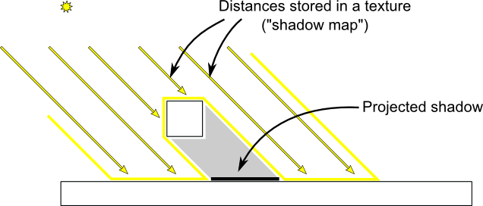
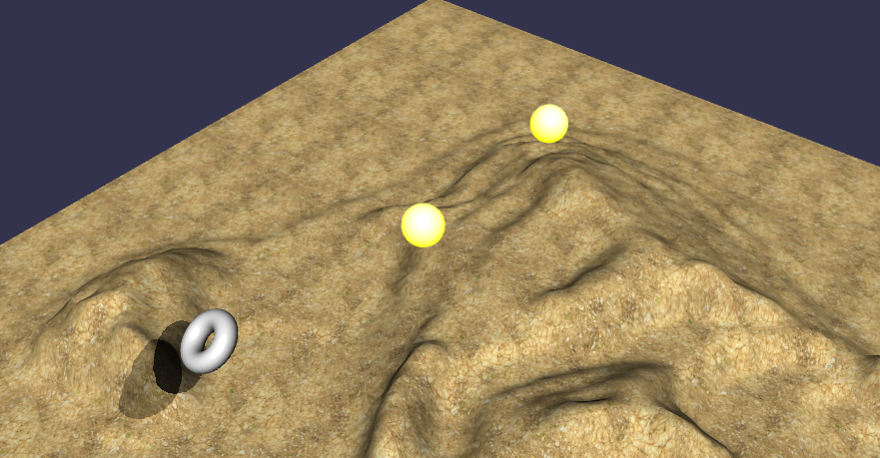
Shadows explained
ShadowGenerator, function that uses a map of your scene generated from the light’s point of view

Slide 7
Shadows configuration
2 parameters used by the shadow generator: size of the shadow map + Directional Light used for the shadow map’s computation
Choose which meshes to put in the render list
Define where the shadows will be displayed
Filters booleans: useVarianceShadowMap or usePoissonSampling
var shadowGenerator = new BABYLON.ShadowGenerator(1024, light);
shadowGenerator.getShadowMap().renderList.push(torus);
ground.receiveShadows = true;

Slide 8
USING SHADOWS
DEMO

Slide 9
Section Two
Environment

Slide 10
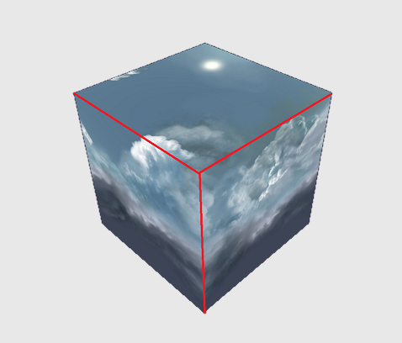
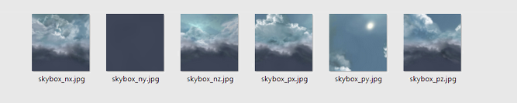
Skyboxes
Use a global box to simulate skies
You have to provide a reflection texture (Cube texture or 6 textures: one for each face)
Based on StandardMaterial.reflectionTexture

Slide 11
USING SKYBOXES
DEMO

Slide 12
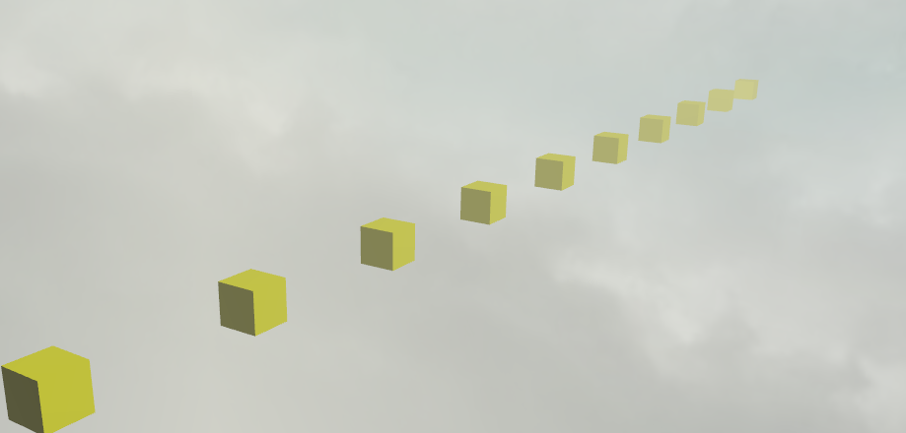
Fog
Add specific color to meshes based on distance
Can be linear or exponential
Defined at scene level

Slide 13
USING FOG
DEMO

Slide 14
Section Three
Lens Flares

Slide 15
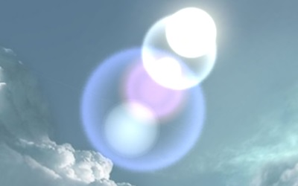
Simulating light scattering in lenses
2D effect applied after 3D rendering
You can define how many artifacts are generated
Each artifact is defined by:
Position on a line between screen’s center (0) and emitter (1)
Opacity
Texture
Based on BABYLON.LensFlareSystem

Slide 16
USING LENS FLARES
DEMO

Slide 17
Section Four
Particles

Slide 18
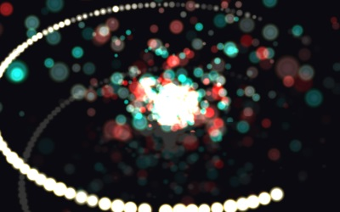
Particles system
Can be used to simulate smoke, fire, water, fairy dust, etc.
Based on BABYLON.ParticleSystem
System is autonomous once you defined all parameters
Particle behavior is by default automatic but can be manually controlled
GPU generated sprites

Slide 19
USING PARTICLES
DEMO

Slide 20
Section Five
Post-processes

Slide 21
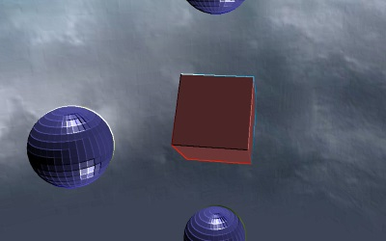
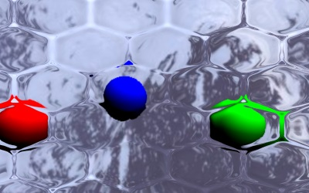
Post-processes
2D fullscreen shader applied after rendering
Defined by camera
Pre-defined post-processes:
Anaglyph
Black and white
Blur
Convolution
DisplayPass
Filter
FXAA
Refraction

Slide 22
USING DEFAULT POST-PROCESSES
DEMO

Slide 23
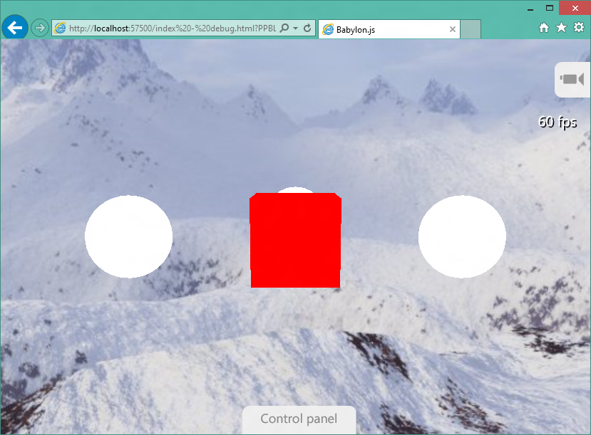
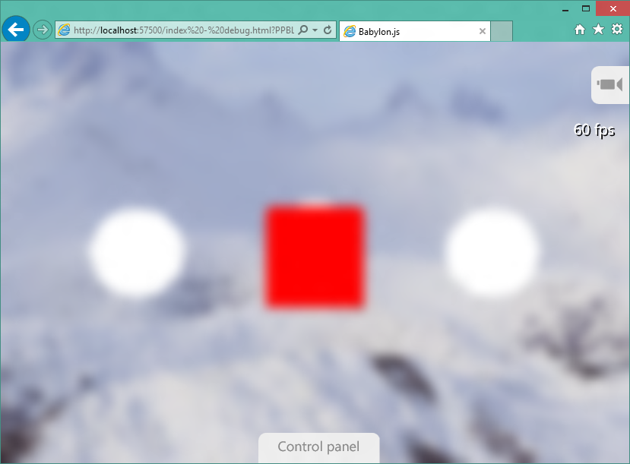
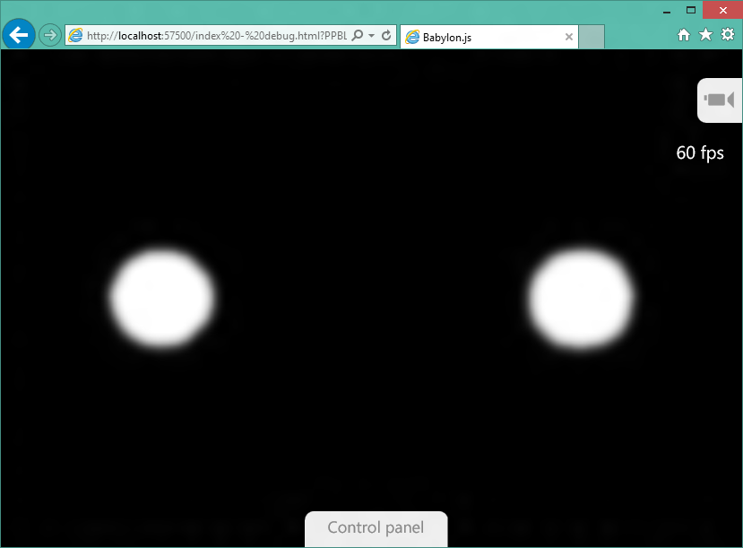
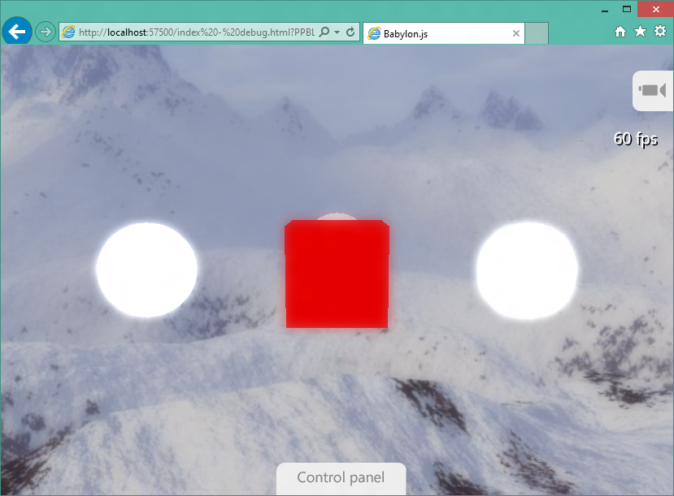
Chaining post-processes
Post-processes can be chained to produce complex effects
scene
blur
glow
bloom

Slide 24
USING DEFAULT POST-PROCESSES
DEMO

Slide 25
Custom post-processes
Custom post-processes can be defined using pixel shaders
Inherit from BABYLON.PostProcess
Define shader code and parameters
Use postprocess.onApply to send variables to shader

Slide 26
CREATING CUSTOM POST-PROCESSES
DEMO

Slide 27
Going further
Shadows
Scene Environment
How to use lens flares
Particles
Creating a small 3D game (includes particules usage)
How to use postprocesses
How to use PostProcessRenderPipeline

